Slide 1
Hiring a Full-Time Data Scientist
Salary Market Analysis & Recommendation
Brian Wrenn

Slide 2
Business Challenge
Company plans to hire a full-time Data Scientist
Pay differs by experience level, location, remote work, and company size
Objectives:
Compare salaries of potential candidates based on different factors:
Experience level
U.S. vs Non-U.S. employees
Remote vs on-site work
Company size

Slide 3
Data and Methodology
Global salary dataset of data science professionals
Filtered to:
Full-time employees
Salaries standardized to U.S. dollars
Key variables:
Salary
Experience level
Employee location
Remote work category
Company size
Final analysis focuses on salaries from small companies similar to ours

Slide 4
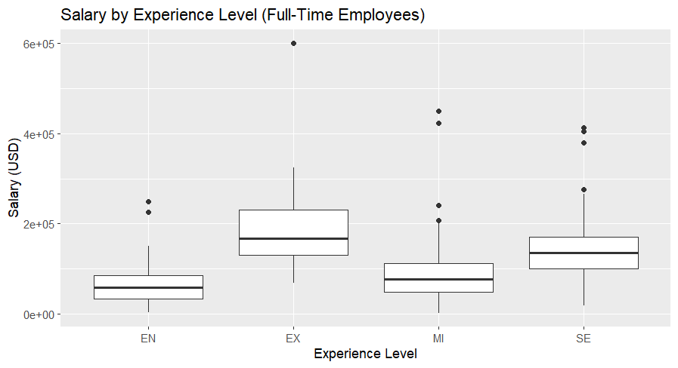
Salary Based on Experience
• Salary increases consistently as experience increases
• Entry-level workers earn the lowest salaries
• Senior and executive employees earn the highest salaries
• Largest increases occur moving from mid-level to senior roles
• Mid-level hiring offers strongest balance of affordability and experience

Slide 5
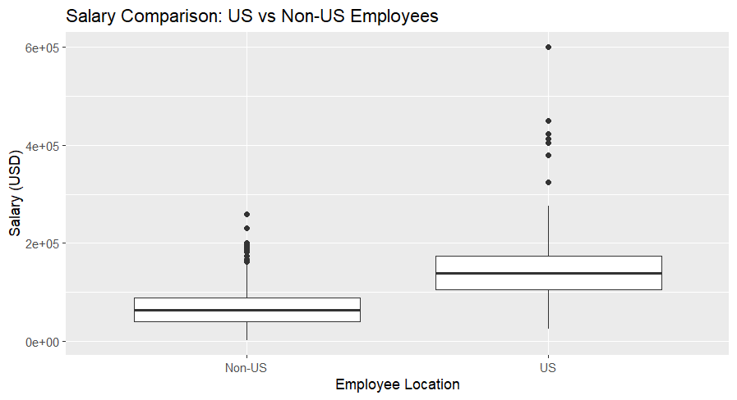
U.S. vs Non-U.S. Salaries
• U.S.-based employees earn higher median salaries
• International hires command lower average compensation
• Salary savings must be balanced against communication and collaboration considerations
• Hiring outside the U.S. reduces cost but may add operational challenges

Slide 6
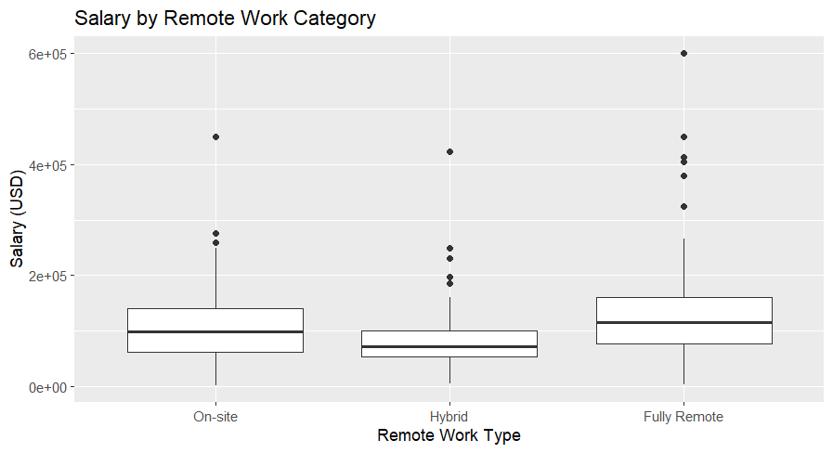
Remote Work
• Salary differences across work arrangements are minimal
• Remote positions do not require higher pay
• Flexibility expands the hiring pool
• Remote hiring increases access to talent without increasing salary costs

Slide 7
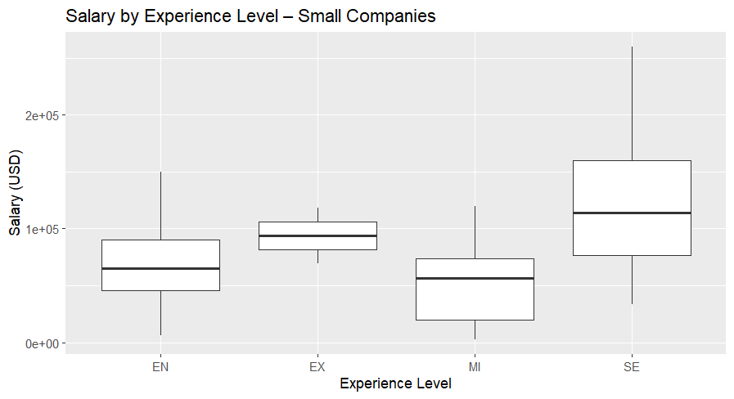
Small Company Salary Benchmarks
• Small companies offer competitive but moderate salaries
• Salary still scales predictably by experience
• Mid-level salary ranges are consistent across the small-company market
• These salaries best represent what our company should expect to pay

Slide 8
Salary Recommendations
Entry Level: $45,896 – $90,000
Mid-Level: $20,000 – $74,000
Senior Level: $76,833 – $160,000
• Mid-level hiring prevents the steep cost associated with senior roles
Offering senior roles will keep company competitive with other firms.

Slide 9
Strategic Considerations
• Primary target: Mid-level Data Scientist
• Offer near the upper half of recommended range to remain competitive
• Offer remote or hybrid positions to expand the hiring pool
• Consider international hiring for cost reduction
• Prioritize mid-level candidates for highest value
• Review compensation annually as market trends change

Slide 10
Conclusion
Experience level is the primary driver of salary difference
U.S. salaries exceed international compensation
Remote work flexibility does not significantly increase costs
Small-company salary benchmarks provide the most realistic budget targets
Final Recommendation
Hire a mid-level Data Scientist at a salary between
$60,000 – $70,000 USD
  This range balances talent quality with cost efficiency for a growing company.

